Slide 1

G2 Crowd - Zapier Integration
Setup Guide
G2 Crowd | #1 B2B Tech Review Platform

Slide 2

G2 CROWD - ZAPIER INTEGRATION SETUP GUIDE
What is Zapier?
Zapier is a web app that lets you automate tasks and connect data between online applications. You can learn more about how Zapier works in their help center. You can use Zapier to get alerts about activity on your G2 Crowd profile.
You can use Zapier to connect G2 Crowd activity with 500+ software products. To do so you will need to sign up for an account. Connecting with many apps are free, but you will need a paid account to connect your G2 Crowd data to Zapier’s premium apps. Paid accounts start at $20/month. Learn more about Zapier pricing.
Free apps include: Gmail, Slack, Pipedrive, HubSpot, Highrise, Asana, and more!
Premium app include: Salesforce CRM, Zendesk, GetResponse, Marketo, and more!
View the full list of apps that integrate with Zapier.

Slide 3
G2 CROWD - ZAPIER INTEGRATION SETUP GUIDE
What can you do with Zapier?
Leads
If you need additional customization beyond the standard webhooks integration G2 Crowd offers, you can use Zapier to automate the sending of leads from G2 Crowd to your own systems.
With Zapier, you can:
Send custom values to your system.
Set up a custom integration.
Visitors
Receive a notification when a new visitor is researching you on your G2 Crowd profile. You can send this notification to email, Slack, or your CRM or Marketing Automation system.
Track Prospects
If you are using G2 Crowd’s Track Your Prospects feature, you can use Zapier to receive a notification when a visitor moves from G2 Crowd to your tracked pages, or vice versa. You can send this notification to email, Slack, or your CRM or Marketing Automation system.

Slide 4

EXAMPLE:
Receive a Slack message when a new visitor views your G2 Crowd profile.

Slide 5
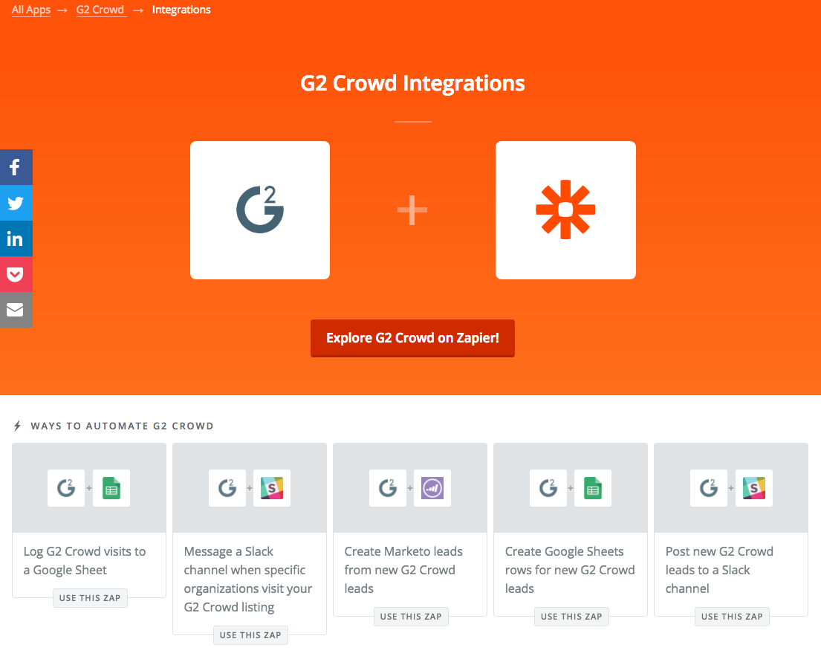
G2 CROWD - ZAPIER INTEGRATION SETUP GUIDE
Example: Slack
Receive a Slack message when a new visitor views your G2 Crowd profile.
Follow this link to begin setting up your G2 Crowd Zap.
Log in or create a new account.
Click the orange ‘Make a Zap with G2 Crowd’ button.

Slide 6
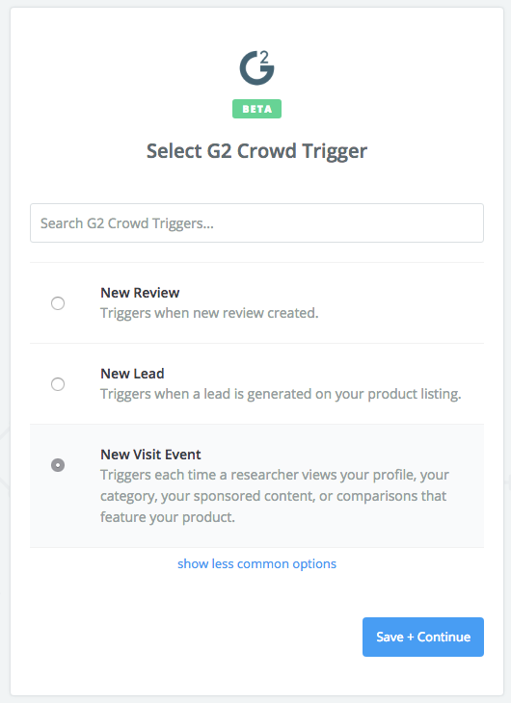
G2 CROWD - ZAPIER INTEGRATION SETUP GUIDE
Example: Slack
Receive a Slack message when a new visitor views your G2 Crowd profile.
Select ‘New Visitor’ as your trigger.
Click the blue ‘Save + Continue’ button.

Slide 7
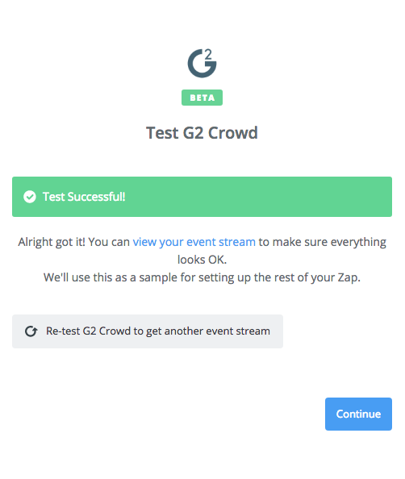
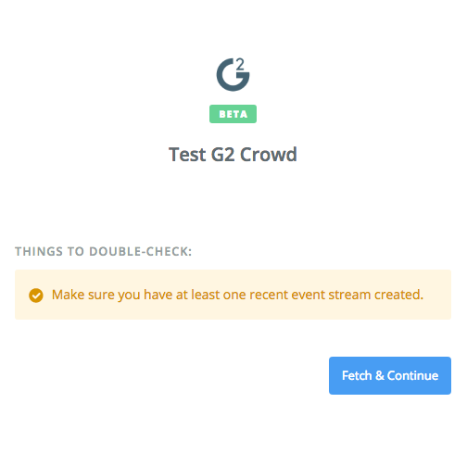
G2 CROWD - ZAPIER INTEGRATION SETUP GUIDE
Example: Slack
Receive a Slack message when a new visitor views your G2 Crowd profile.
Test and confirm your trigger.

Slide 8
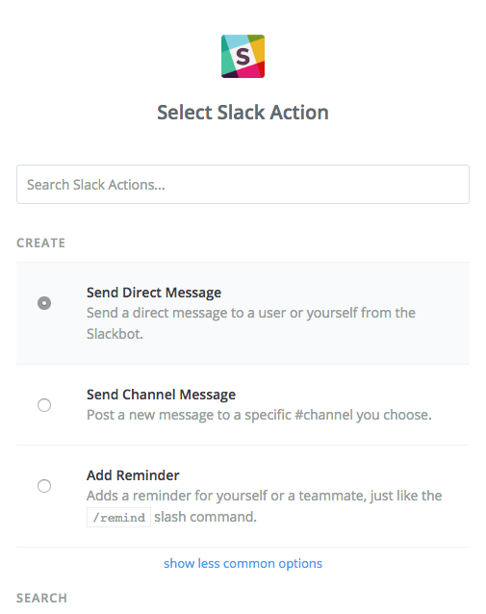
G2 CROWD - ZAPIER INTEGRATION SETUP GUIDE
Example: Slack
Receive a Slack message when a new visitor views your G2 Crowd profile.
Choose the action you want to occur. For example, to receive a direct Slack message when a new visitor views your G2 Crowd profile, choose the ‘Send Direct Message’ option.
Click the blue ‘Save + Continue’ button.

Slide 9
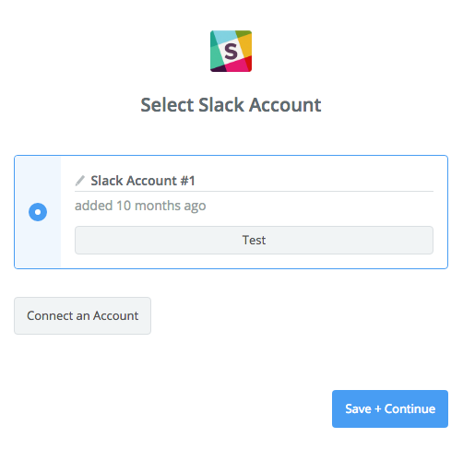
G2 CROWD - ZAPIER INTEGRATION SETUP GUIDE
Example: Slack
Receive a Slack message when a new visitor views your G2 Crowd profile.
Connect the account that will be receiving the message.
Click the blue ‘Save + Continue’ button.

Slide 10
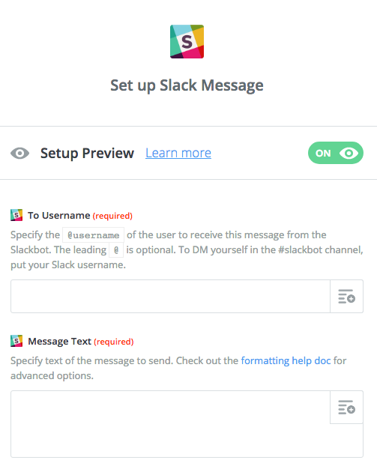
G2 CROWD - ZAPIER INTEGRATION SETUP GUIDE
Example: Slack
Receive a Slack message when a new visitor views your G2 Crowd profile.
Set up your message template under ‘Message Text’. You can type in regular text or use G2 Crowd lead form values.
To view G2 Crowd lead form values, click the icon on the right-hand side.
Select the values you would like to use and proceed to the next step.

Slide 11
G2 CROWD - ZAPIER INTEGRATION SETUP GUIDE
Example: Slack
Receive a Slack message when a new visitor views your G2 Crowd profile.
When you are ready to turn on your Zap, give it a name and set the toggle to ‘ON’.
Zapier will start sending your data from G2 Crowd to the system you chose.

Slide 12
EXAMPLE:
Customize your lead values.

Slide 13
G2 CROWD - ZAPIER INTEGRATION SETUP GUIDE
Example: Lead Values
Receive a Slack message when a new visitor views your G2 Crowd profile.
Follow this link to begin setting up your G2 Crowd Zap.
Log in or create a new account.
Click the orange ‘Make a Zap with G2 Crowd’ button.

Slide 14
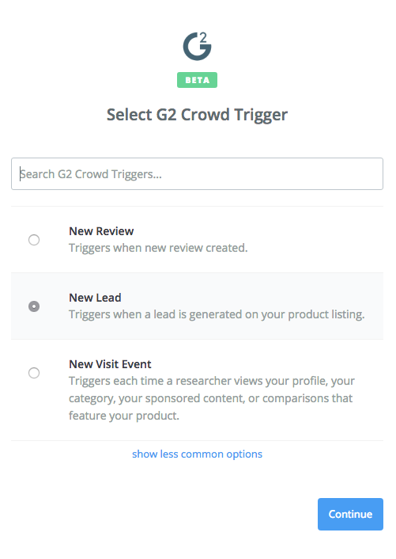
G2 CROWD - ZAPIER INTEGRATION SETUP GUIDE
Example: Lead Values
Receive a Slack message when a new visitor views your G2 Crowd profile.
Select ‘New Lead’ as your trigger.
Click the blue ‘Save + Continue’ button.

Slide 15
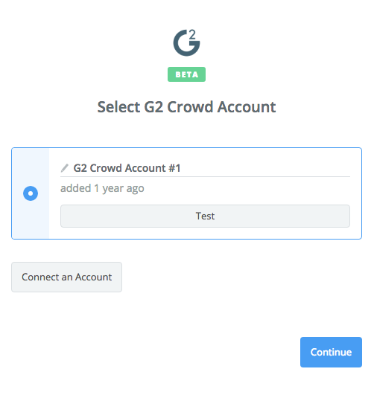
G2 CROWD - ZAPIER INTEGRATION SETUP GUIDE
Example: Lead Values
Receive a Slack message when a new visitor views your G2 Crowd profile.
Connect your account in the next step. You will need to retrieve the API token from your G2 Crowd admin portal under the ‘API Tokens’ tab.
If you need to make a new token, create a label and click ‘Create New Token’.

Slide 16
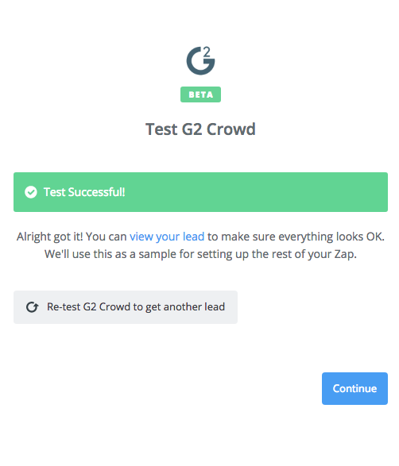
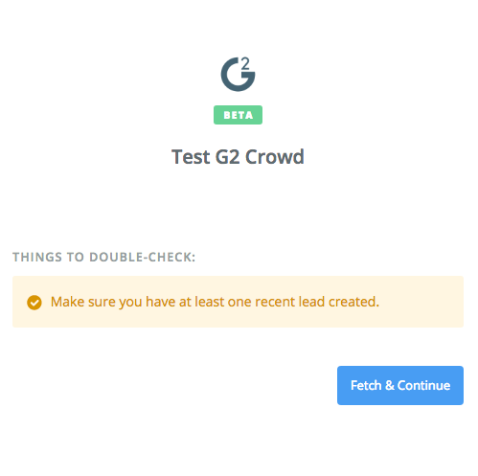
G2 CROWD - ZAPIER INTEGRATION SETUP GUIDE
Example: Slack
Receive a Slack message when a new visitor views your G2 Crowd profile.
Test and confirm your trigger.

Slide 17
G2 CROWD - ZAPIER INTEGRATION SETUP GUIDE
Example: Lead Values
Receive a Slack message when a new visitor views your G2 Crowd profile.
Set up your action. In this example, the first action we will take is to map out our custom values using the ‘Formatter’ app.

Slide 18
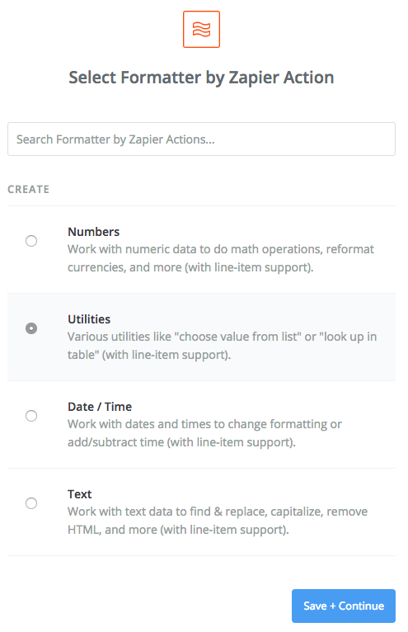
G2 CROWD - ZAPIER INTEGRATION SETUP GUIDE
Example: Lead Values
Receive a Slack message when a new visitor views your G2 Crowd profile.
Choose ‘Utilities’ as the action to create.

Slide 19
G2 CROWD - ZAPIER INTEGRATION SETUP GUIDE
Example: Lead Values
Receive a Slack message when a new visitor views your G2 Crowd profile.
Now set up the data transformation using the Lookup Table option. Here we will be transforming the company size value from G2 Crowd to custom values.
Enter the Lookup Key ‘Company Size’ and enter the mapping you want to use in the Lookup Table.
Use the left-hand column to insert the company size values from G2 Crowd. Use the right-hand column to insert the custom values you want the G2 Crowd ones to map to.
You can enter an optional fallback value as well.

Slide 20
G2 CROWD - ZAPIER INTEGRATION SETUP GUIDE
Example: Lead Values
Receive a Slack message when a new visitor views your G2 Crowd profile.
In the next step, you will send the transformed data via webhooks to your system using an external URL.
Set up a new action, selecting the ‘Webhooks’ Action App.
On the next step, chose ‘POST’ as the Webhooks Action.

Slide 21
G2 CROWD - ZAPIER INTEGRATION SETUP GUIDE
Example: Lead Values
Receive a Slack message when a new visitor views your G2 Crowd profile.
Next, set up the template for the data that you will send. Enter the URL where the data will be sent, and, optionally, the Payload Type and specified Data fields.
Proceed to the next step and test the configuration.

Slide 22
G2 CROWD - ZAPIER INTEGRATION SETUP GUIDE
Example: Lead Values
Receive a Slack message when a new visitor views your G2 Crowd profile.
When you are ready to turn on your Zap, give it a name and set the toggle to ‘ON’.
Zapier will start sending your data from G2 Crowd to the system you chose.

Slide 23


